Slide 1
BLE MARK
A Smart Bluetooth-Based Attendance System
This presentation is about our Smart Attendance System. It helps schools take attendance in a modern and automatic way.
The system uses special technology to sense nearby devices. It also keeps attendance records safe, accurate, and easy to see.

Slide 2
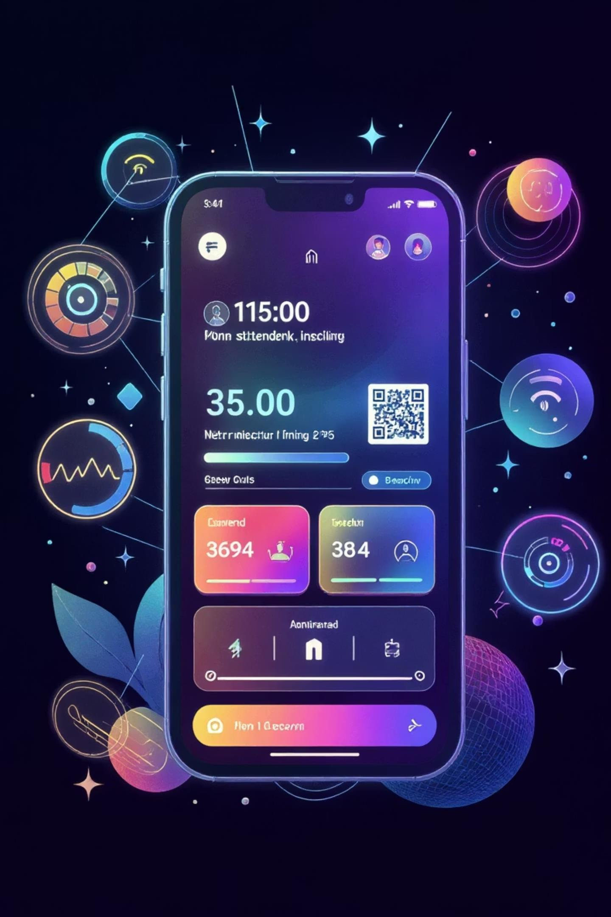

Introduction to project
Automatic Student Detection
QR Code Backup
The main way this system works is by using the teacher's app. It uses Bluetooth Low Energy (BLE) to find students' phones nearby and mark them present automatically
If BLE doesn't work, there's a backup. The student's app creates a special code and shows a QR code. Teachers can scan this to record attendance.
Safe Data Storage
All student details and attendance records are stored safely. We use a Firebase Realtime Database to keep all information secure and organized.

Slide 3


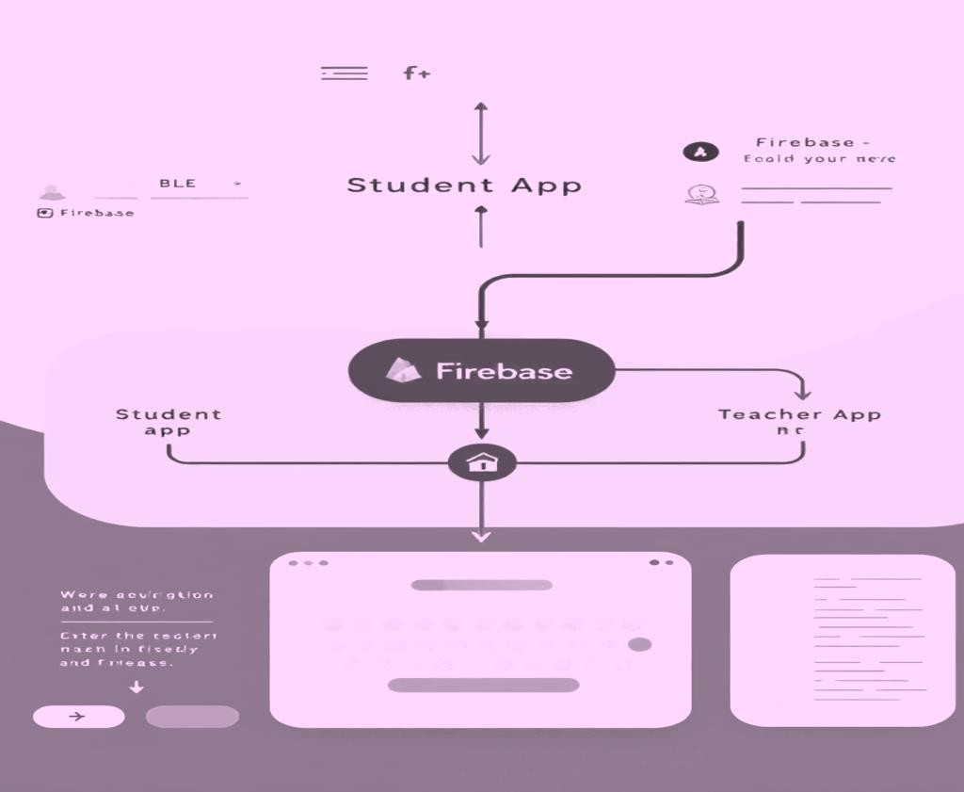

Frontend & Backend
Backend
Firebase Realtime Database: Stores all attendance and student information.
Firebase Cloud Messaging: Sends instant messages, like when attendance is recorded or important alerts.
BLE + UUID: This is how the app finds nearby students and gives them a special ID to mark attendance.
One App for All Phones
We built the app with Flutter. This means it works smoothly on both Android and Apple phones from one set of code.
Clear & Modern Look
The Admin app uses a
blue-green
style, and the Student app uses a
purple-blue
style.
Both look modern and easy to use.
Safe Logins
We use Firebase Authentication to make sure teachers and students can log in safely and easily.

Slide 4
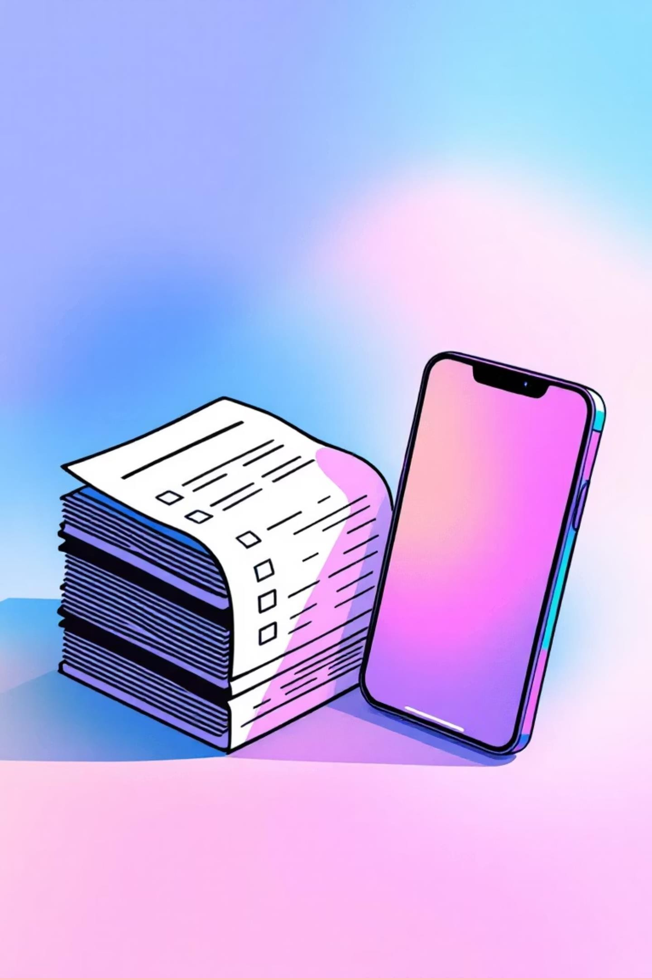
A New Way to Mark Attendance
Difference from existing projects
Old Systems Needs extra hardware: Often uses expensive, fixed devices like card readers. Slow and causes issues: Manual scanning is slow and can create delays. Few features: Often lacks things like teacher approvals or students checking their own records. Expensive to run: High starting costs and ongoing maintenance for physical tools.
BLE MARK No hardware needed: Works completely on a mobile app, no extra devices required. Fast and dependable: Uses quick Bluetooth detection, with QR codes as a backup. Clearer and more open: Teachers can approve, and students can see their daily and subject attendance. Cheaper and easy to grow: Lower costs over time and simple to use for many schools.

Slide 5





Project Plan & Next Steps
Smart Data Analysis
Use AI to track student progress. This helps find attendance trends and spot students who might be falling behind.
Location Check
Location Check Add a feature to confirm students are in the right classroom or campus area before marking them present.
Campus Overview
Create easy-to-read reports to manage attendance data for all campuses and teachers. This improves how schools oversee things.
These updates will make the system more than just an attendance tracker. It will become a strong tool for school management and student help.

Slide 6

Concluding Remarks
Simple, Clear, and Digital
The Smart Attendance System makes tracking attendance easy. It ensures students and teachers have clear information. It also helps schools become more digital, which is key for modern education.
90%
Time Saved
Much less manual work for each class.
100%
Accurate Data
No more human mistakes when recording attendance.
24/7
Instant Access
Authorized users can see attendance records anytime, right away.

Slide 7

Thank You
Questions & Discussion
Thank you for your time and for considering the Smart Attendance System. We are now ready to answer your questions about how it works, how it can grow, and its future potential.

